Slide 1
ALGORITHMIC PARADIGMS

Slide 2
Algorithmic Paradigms
These are general techniques to design algorithms
  Divide and Conquer
  Greedy
  Dynamic Programming

Slide 3
Divide and Conquer
Divide the problem into almost equal sized subproblems
Solve the subproblems recursively
Combine the results of the subproblems to get the result for the original problem

Slide 4
Divide and Conquer
Divide the problem into almost equal sized subproblems
Solve the subproblems recursively
Combine the results of the subproblems to get the result for the original problem
T(N) = a T(N/b) + C(N)

Slide 5
Divide and Conquer
Fast Integer Multiplication
Merge Sort

Slide 6
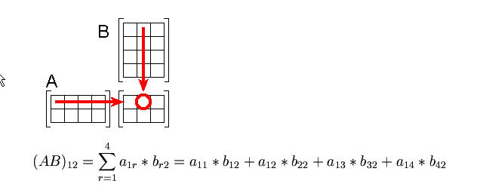
Divide and Conquer
Matrix Multiplication
“High School” algorithm

Slide 7
EXAMPLE
Matrix Multiplication C_{nxn} = A_{nxn} * B_{nxn}
for (i=1; i <= N; i++)
for (j=1; j <= N; j++) {
C[i][j] = 0.0
for (k = 1; k<= N; k++)
C[i][j] = C[i][j] + A[i][k]* B[k][j];
}
A total of about N³ floating point additions and multiplications take place here . Everything else takes place about αN² times.
Hot Spot

Slide 8
Divide and Conquer
Matrix Multiplication
A_{nxn} * B_{nxn} = C_{nxn}
“High School” Algorithm takes O(n³) time
  We need to compute n² dot-products of row and column vectors
  Each dot product needs n multiplications and n-1 additions.

Slide 9
Matrix Multiplication
Consider a Square Matrix of size nxn where n=2^{k} for some k.

Slide 10
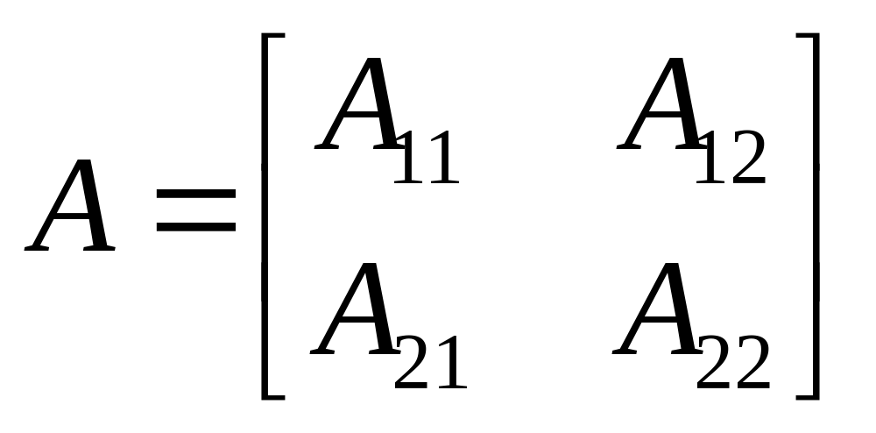
Matrix Multiplication
Consider a Square Matrix of size nxn where n=2^{k} for some k.

Slide 11
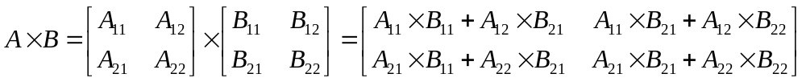
Matrix Multiplication

Slide 12
Matrix Multiplication
Note Recursion

Slide 13
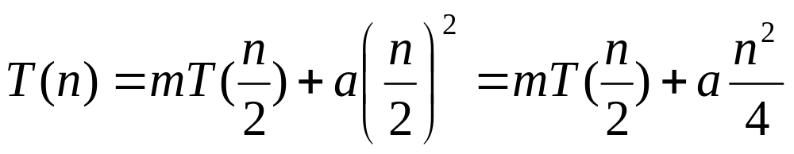
Matrix Multiplication
Note Recursion
m=8 multiplications
a=4 additions

Slide 14
Matrix Multiplication
Note Recursion
m=8 multiplications
a=4 additions

Slide 15
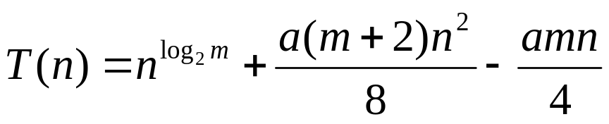
Matrix Multiplication
has a general solution

Slide 16
Matrix Multiplication
has a general solution
Note that additions only affect low order term!

Slide 17

Matrix Multiplication
for the high school algorithm we have m = 8 and a = 4, so we have
So it seems we did not gain much from divide and conquer

Slide 18
Matrix Multiplications
We need to reduce the number of multiplications, m, if we are to make any gains.

Slide 19
Matrix Multiplications
We need to reduce the number of multiplications, m, if we are to make any gains.
Strassen’s algorithm

Slide 20
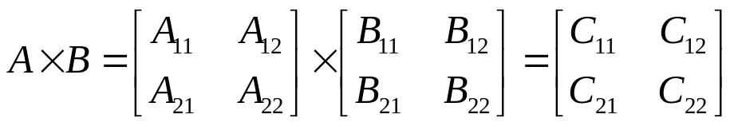
Strassen’s Algorithm
P1 = (A11+ A22) * (B11+B22)
P2 = (A21 + A22) * B11
P3 = A11 * (B12 - B22)
P4 = A22 * (B21 - B11)
P5 = (A11 + A12) * B22
P6 = (A21 - A11) * (B11 + B12)
P7 = (A12 - A22) * (B21 + B22)
C11 = P1 + P4 - P5 + P7
C12 = P3 + P5
C21 = P2 + P4
C22 = P1 + P3 - P2 + P6
We have m=7 and a=18

Slide 21
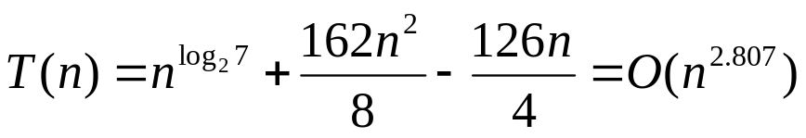
Strassen’s Algorithm
P1 = (A11+ A22) * (B11+B22)
P2 = (A21 + A22) * B11
P3 = A11 * (B12 - B22)
P4 = A22 * (B21 - B11)
P5 = (A11 + A12) * B22
P6 = (A21 - A11) * (B11 + B12)
P7 = (A12 - A22) * (B21 + B22)
C11 = P1 + P4 - P5 + P7
C12 = P3 + P5
C21 = P2 + P4
C22 = P1 + P3 - P2 + P6
We have m=7 and a=18

Slide 22
Lesson
A single multiplication saved in the recursive step reduces the exponent of the time function!

Slide 23
Matrix Multiplication
Best result known is due to Coppersmith and Winograd O(n^{2.376})
Trivial lower bound is Ω(n²) since we have to produce n² elements of the result matrix.

Slide 24
Greedy Algorithms
Typically applies to optimization problems
Obtain an optimal solution to a problem by making a sequence of choices
The choice that seems best at the moment is chosen

Slide 25
Example: Counting money
Suppose you want to count out a certain amount of money, using the fewest possible bills and coins
A greedy algorithm would be:
At each step, take the largest possible bill or coin that does not overshoot
  Example: To make 6.39TL, you can choose:
    A 5 TL bill
    A 1 TL bill, to make 6 TL
    a 25 kurus coin, to make 6.25 TL
    A 10 kurus coin, to make 6.35 TL
    four 1 kurus coins, to make 6.39 TL
For Turkish money, the greedy algorithm always gives the optimum solution
Notes:
3

Slide 26
A failure of the greedy algorithm
In some (fictional) monetary system, “krons” come in 1 kron, 7 kron, and 10 kron coins
Using a greedy algorithm to count out 15 krons, you would get
  A 10 kron coin
  Five 1 kron coins, for a total of 15 krons
  This requires six coins
A better solution would be to use two 7 kron coin and one 1 kron coin
  This only requires three coins
The greedy algorithm results in a solution, but not in an optimal solution
Notes:
4

Slide 27
Examples of Greedy Algorithms
Dijkstra’s weighted shortest path algorithm
  Always takes the lowest-cost path
Kruskal’s algorithm for finding a minimum spanning tree
  Always tries the lowest-cost remaining edge
Prim’s algorithm for finding a minimum spanning tree
  Always takes the lowest-cost edge between nodes in the spanning tree and nodes not yet in the spanning tree

Slide 28
Greedy Algorithms
Do the simplest obvious thing at every step
Sometimes works
  Dijkstra’s shortest path algorithm (given that no edge exists with a negative cost) and minimum spanning tree algorithms

Slide 29
Greedy Algorithms
Do the simplest obvious thing at every step
Sometimes works
  Dijkstra’s shortest path algorithm (given that no edge exists with a negative cost) and minimum spanning tree algorithms
Sometimes does not work but may be acceptable
  Travelling Salesman Problem

Slide 30
Traveling salesman
A salesman must visit every city (starting from city A), and wants to cover the least possible distance
  He can revisit a city (and reuse a road) if necessary
He does this by using a greedy algorithm: He goes to the next nearest city from wherever he is
From A he goes to B
From B he goes to D
This is not going to result in a shortest path!
The best result he can get now will be ABDBCE, at a cost of 16
An actual least-cost path from A is ADBCE, at a cost of 14
A
B
C
2
4
3
3
4
4
D
E
Notes:
10

Slide 31
Encoding Text Files
Suppose we are given a text file containing N characters each of which comes from alphabet ∑ and C= |∑| is the number of characters in the alphabet
If equal length encoding is used
  N * ⎡log |∑|⎤ = ⎡N * log C⎤ bits required
  ⎡log C⎤ is the number of bits required to encode a character in the alphabet

Slide 32
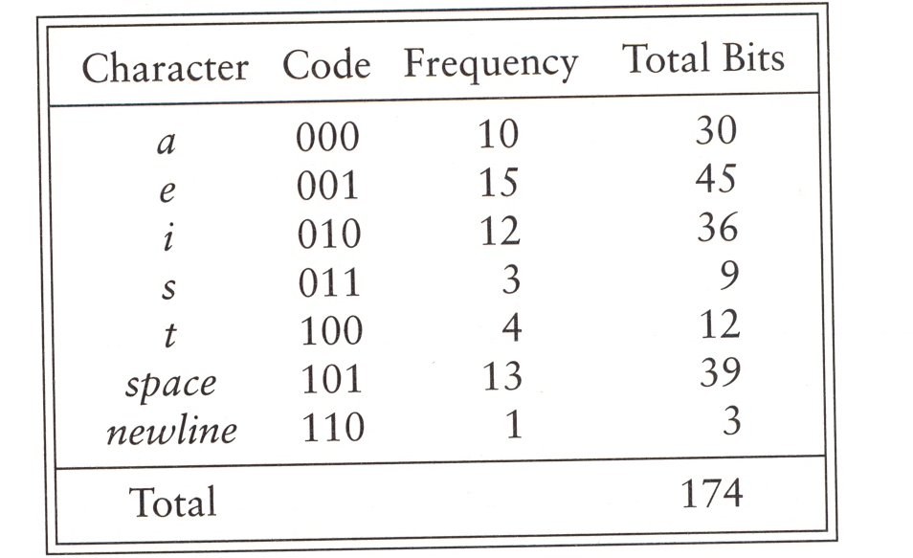
There is often disparity between the most frequent and less frequent characters
Notes:
variable-length encoding

Slide 33
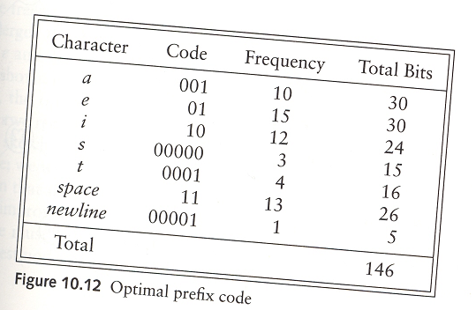
Huffman Codes
Allow the code length vary from character to character and ensure that the frequently occurring characters have short codes
Notes:
variable-length encoding

Slide 34
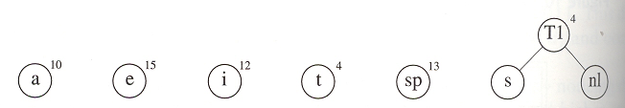
Huffman Codes
Start with a forest of trees each of which initially contains only one character
Combine the two trees of smallest weight
  The weight of a tree is the sum of the frequencies of its leaves.
Notes:
Huffman coding

Slide 35
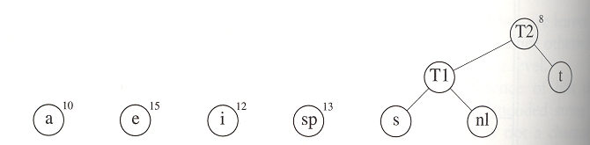
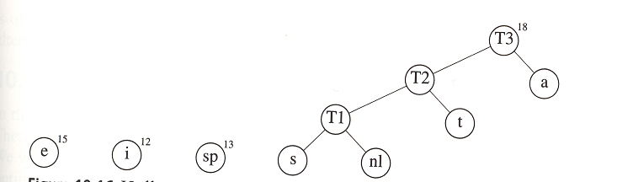
Huffman Codes
Continue in the same fashion until there is one tree

Slide 36
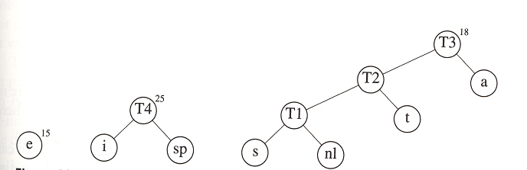
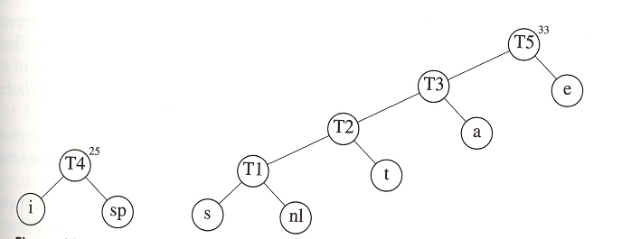
Huffman Codes

Slide 37
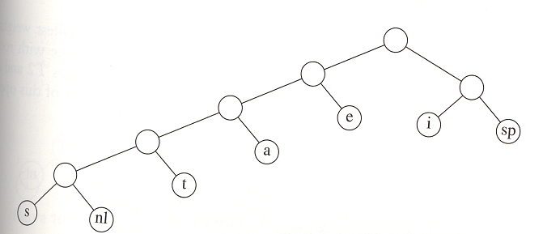
Huffman Codes

Slide 38
Huffman Codes
000101001 → tea
Note that since the characters are placed only at the leaves, any sequence of bits can always be decoded unambiguously.

Slide 39
Huffman Codes
Any sequence of bits can always be decoded unambiguously
That’s because no character code is a prefix of another character code
Such an encoding is known a prefix code
Furthermore, Huffman algorithm yields an optimal code (Why?)

Slide 40
Ambiguity
001
  aab
  cb
  ad
a
b
c
d

Slide 41
Complexity analysis
Suppose we have C characters
If we use a (min) heap of trees, ordered by weight
  Maximum number of elements in the heap: C
  buildHeap: O(C)
  2C – 2 deleteMin operations
    A total of C – 1 iterations each of which performs 2 deleteMins
  C – 2 insert operations
    One insert per iteration, except for the last one
  Total = O(C + (3C-4)log C) = O(ClogC)
  If we use a linked list
    Insertions : O((C-2)*1) = O(C)
    deleteMins O((2C – 2) * C) = O(C²)
    Total: O(C + C²) = O(C²)

Slide 42
Dynamic Programming
Dynamic programming, like divide-and-conquer method, solves problems by combining solutions to subproblems
Divide-and-conquer method
  Partitions the problem into independent subproblems
  Solves the subproblems recursively
  Combine their solutions to solve the original problem
Note that if the subproblems share some common subsubproblems, divide-and-conquer method repeatedly solve the common subsubproblems

Slide 43
Fibonacci Numbers
  long int fib( int n){
  if (n <= 1) return( 1 );
  else return( fib (n – 1) + fib (n – 2) );
  }
F(6)
F (5)
F(4)
F(3)
F(2)
F(4)
F(3)
F(2)
F(1)
F(1)
F(0)
F(3)
F(2)
F(2)
F(1)
F(1)
F(0)
F(2)
F(1)
F(1)
F(0)
F(1)
F(0)
F(1)
F(0)

Slide 44
Dynamic Programming
In contrast, dynamic programming is applicable when the subproblems are not independent, i.e., when they share some common subsubproblems.
The general idea is to solve every subsubproblem just once and save its answer in a table.
Useful in optimization problems when a sequence of decisions have to be made

Slide 45
Typical Steps in Dynamic Programming
Characterize the structure of an optimal solution
Recursively define the value of an optimal solution
Compute the value of an optimal solution in a bottom-up/top-down fashion
Construct an optimal solution from computed information
Notes:
Memoization top-down
Tabulation buttom-up

Slide 46
When to Apply
Typically applies to optimization problems
Two ingredients that an optimization problem must have
Overlapping subproblems
  Space of subproblems must be “small” in the sense that a recursive algorithm solves the same subproblems over and over again
Optimal substructure
  Optimal solution to the problem contains within it optimal solutions to the subproblems

Slide 47
Dynamic Programming
Matrix Chain Multiplication
Longest Common Subsequence

Slide 48
Matrix Chain Multiplication
We wish to compute
  A₁A₂A₃...A_{n}
  A_{i} are matrices of appropriate sizes
    A_{i} has size p_{i-1}by p_{i} and A_{i+1} has size p_{i} by p_{i+1}
    Multiplying A_{i} and A_{i+1} takes O(p_{i-1}p_{i}p_{i+1}) operations.

Slide 49
Matrix Chain Multiplication
We wish to compute
  A₁A₂A₃...A_{n} (note associativity)
  A_{i} are matrices of appropriate sizes
    (A₁ (A₂ (A₃...A_{n})))
    ((A₁ (A₂A₃))...A_{n})
    .......
  In how many ways, can you multiply n matrices?

Slide 50
Matrix Chain Multiplication
A1 30 x 35
A2 35 x 15
A3 15 x 5
A1 x (A2 x A3) needs
  35*15*5+30*35*5= 7875 operations
(A1 x A2) x A3 needs
  30*35*15 + 30*15*5= 18000 operations

Slide 51
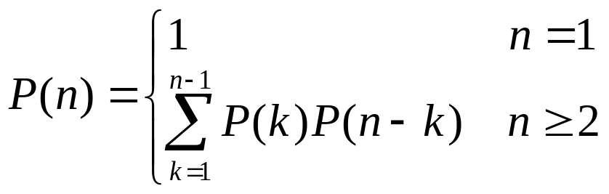
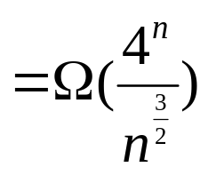
Matrix Chain Multiplication
Suppose that the matrices are A₁ … A_{n}, and the last multiplication performed is (A₁ ...A_{k})(A_{k+1}…A_{n})
When k=1, (A₁)(A₂…A_{n})
When k=n-1, (A₁…A_{n-1})(A_{n})
P(n)s are known as Catalan numbers

Slide 52
Matrix Chain Multiplication
Suppose that the matrices are A₁ … A_{n}, and the last multiplication performed is (A₁ ...A_{k})(A_{k+1}…A_{n})
Subproblems
P(n)s are known as Catalan numbers

Slide 53
Matrix Chain Multiplication
Suppose that the matrices are A₁ … A_{n}, and the last multiplication performed is (A₁ ...A_{k})(A_{k+1}…A_{n})
Number of ways you can multiply the first k
matrices
P(n)s are known as Catalan numbers

Slide 54
Matrix Chain Multiplication
Suppose that the matrices are A₁ … A_{n}, and the last multiplication performed is (A₁ ...A_{k})(A_{k+1}…A_{n})
Number of ways you can multiply the
remaining n-k matrices.
Number of ways you can multiply the first k
matrices
P(n)s are known as Catalan numbers

Slide 55
Matrix Chain Multiplication
Suppose that the matrices are A₁ … A_{n}, and the last multiplication performed is (A₁ ...A_{k})(A_{k+1}…A_{n})
Number of ways you can multiply the
remaining n-k matrices.
Number of ways you can multiply the first k
matrices
Sum over all possible
k’s
P(n)s are known as Catalan numbers

Slide 56
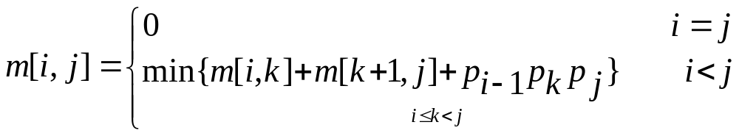
Subproblems
m[i,j]: minimum cost of multiplying A_{i} ...A_{j}
Suppose that the last multiplication is
(A_{i} ...A_{k})(A_{k+1}..A_{j})

Slide 57
Subproblems
m[i,j]: minimum cost of multiplying A_{i} ...A_{j}
Suppose that the last multiplication is
(A_{i} ...A_{k})(A_{k+1}..A_{j})
(A_{i} ...A_{k})(A_{k+1}..A_{j})
Best Way to Calculate A_{i} ...A_{j}
p_{i-1} by p_{k}
p_{k} by p_{j}

Slide 58
Subproblems
m[i,j]: minimum cost of multiplying A_{i} ...A_{j}
Suppose that the last multiplication is
(A_{i} ...A_{k})(A_{k+1}..A_{j})
(A_{i} ...A_{k})(A_{k+1}..A_{j})
Best Way to Calculate A_{i} ...A_{j}
p_{k} by p_{j}
We only need to try k=i to k=j-1

Slide 59
Subproblems
m[i,j]: minimum cost of multiplying A_{i} ...A_{j}
Suppose that the last multiplication is
There are only approximately N²/2 values of m[i, j] that ever need to be computed, i.e., N + (N-1) + (N-2) + … + 1
  A table can be used to store them
(A_{i} ...A_{k})(A_{k+1}..A_{j})

Slide 60
Solving The Problem (A₁A₂A₃A₄)
i=1
i=2
i=3
i=4
j=4
A₁A₂A₃A₄
A₂A₃A₄
j=3
A₂A₃
j=2
A₂
j=1
A₁

Slide 61
Solving The Problem (A₁A₂A₃A₄)
i=1
i=2
i=3
i=4
j=4
m[4,4]=0
j=3
m[3,3]=0
j=2
m[2,2]=0
A₁A₂
When k=1, (A₁)(A₂)
  m[1,1] + m[2,2] + p₀p₁p₂
j=1
m[1,1]=0

Slide 62
Solving The Problem (A₁A₂A₃A₄)
i=1
i=2
i=3
i=4
j=4
m[4,4]=0
j=3
m[3,3]=0
j=2
m[1,2]
m[2,2]=0
A₁A₂
When k=1, (A₁)(A₂)
  m[1,1] + m[2,2] + p₀p₁p₂
j=1
m[1,1]=0

Slide 63
Solving The Problem (A₁A₂A₃A₄)
i=1
i=2
i=3
i=4
j=4
m[4,4]=0
j=3
m[3,3]=0
A₂A₃
When k=2, (A₂)(A₃)
  m[2,2] + m[3,3] + p₁p₂p₃
j=2
m[1,2]
m[2,2]=0
j=1
m[1,1]=0

Slide 64
Solving The Problem (A₁A₂A₃A₄)
i=1
i=2
i=3
i=4
j=4
m[4,4]=0
j=3
m[2,3]
m[3,3]=0
A₂A₃
When k=2, (A₂)(A₃)
  m[2,2] + m[3,3] + p₁p₂p₃
j=2
m[1,2]
m[2,2]=0
j=1
m[1,1]=0

Slide 65
Solving The Problem (A₁A₂A₃A₄)
i=1
i=2
i=3
i=4
j=4
m[3,4]
m[4,4]=0
j=3
m[2,3]
m[3,3]=0
j=2
m[1,2]
m[2,2]=0
j=1
m[1,1]=0

Slide 66
Solving The Problem (A₁A₂A₃A₄)
i=1
i=2
i=3
i=4
j=4
m[3,4]
m[4,4]=0
j=3
m[2,3]
m[3,3]=0
A₁A₂A₃
When k=1, (A₁)(A₂ A₃)
  m[1,1] + m[2,3] + p₀p₁p₃
When k=2, (A₁ A₂) (A₃)
  m[1,2] + m[3,3] + p₀p₂p₃
Pick the minimum cost
j=2
m[1,2]
m[2,2]=0
j=1
m[1,1]=0

Slide 67
Solving The Problem (A₁A₂A₃A₄)
i=1
i=2
i=3
i=4
j=4
m[3,4]
m[4,4]=0
j=3
m[1,3]
m[2,3]
m[3,3]=0
A₁A₂A₃
When k=1, (A₁)(A₂ A₃)
  m[1,1] + m[2,3] + p₀p₁p₃
When k=2, (A₁ A₂) (A₃)
  m[1,2] + m[3,3] + p₀p₂p₃
Pick the minimum cost
j=2
m[1,2]
m[2,2]=0
j=1
m[1,1]=0

Slide 68
Solving The Problem (A₁A₂A₃A₄)
i=1
i=2
i=3
i=4
j=4
m[3,4]
m[4,4]=0
j=3
m[1,3]
m[2,3]
m[3,3]=0
A₂A₃A₄
When k=2, (A₂)(A₃ A₄)
  m[2,2] + m[3,4] + p₁p₂p₄
When k=3, (A₂ A₃) (A₄)
  m[2,3] + m[4,4] + p₁p₃p₄
Pick the minimum cost
j=2
m[1,2]
m[2,2]=0
j=1
m[1,1]=0

Slide 69
i=1
i=2
i=3
i=4
j=4
m[2,4]
m[3,4]
m[4,4]=0
j=3
m[1,3]
m[2,3]
m[3,3]=0
A₂A₃A₄
When k=2, (A₂)(A₃ A₄)
  m[2,2] + m[3,4] + p₁p₂p₄
When k=3, (A₂ A₃) (A₄)
  m[2,3] + m[4,4] + p₁p₃p₄
Pick the minimum cost
j=2
m[1,2]
m[2,2]=0
j=1
m[1,1]=0

Slide 70
i=1
i=2
i=3
i=4
j=4
m[2,4]
m[3,4]
m[4,4]=0
j=3
m[1,3]
m[2,3]
m[3,3]=0
A₁A₂A₃A₄
When k=1, (A₁)(A₂ A₃ A₄)
  m[1,1] + m[2,4] + p₀p₁p₄
When k=2, (A₁ A₂)(A₃ A₄)
  m[1,2] + m[3,4] + p₀p₂p₄
When k=3, (A₁ A₂ A₃)(A₄)
  m[1,3] + m[4,4] + p₀p₃p₄
Pick the minimum cost
j=2
m[1,2]
m[2,2]=0
j=1
m[1,1]=0

Slide 71
Solving The Problem (A₁A₂A₃A₄)
i=1
i=2
i=3
i=4
j=4
m[1,4]
m[2,4]
m[3,4]
m[4,4]=0
j=3
m[1,3]
m[2,3]
m[3,3]=0
A₁A₂A₃A₄
When k=1, (A₁)(A₂ A₃ A₄)
  m[1,1] + m[2,4] + p₀p₁p₄
When k=2, (A₁ A₂)(A₃ A₄)
  m[1,2] + m[3,4] + p₀p₂p₄
When k=3, (A₁ A₂ A₃)(A₄)
  m[1,3] + m[4,4] + p₀p₃p₄
Pick the minimum cost
j=2
m[1,2]
m[2,2]=0
j=1
m[1,1]=0

Slide 72
Solving The Problem (A₁A₂A₃A₄)
i=1
i=2
i=3
i=4
j=4
10
9
7
4
j=3
8
6
3
j=2
5
2
Evaluation order
j=1
1

Slide 73
Solving The Problem (A₁A₂A₃A₄)
i=1
i=2
i=3
i=4
j=4
10
9
7
4
j=3
8
6
3
O(n²) subproblems each
requiring O(n) time = O(n³)
j=2
5
2
j=1
1

Slide 74
Solving The Problem (A₁A₂A₃A₄)
i=1
i=2
i=3
i=4
j=4
10
9
7
4
j=3
8
6
3
j=2
5
2
In general each subproblem
will be computed only once
but used many times.
j=1
1

Slide 75
Solving The Problem (A₁A₂A₃A₄)
i=1
i=2
i=3
i=4
j=4
10
9
7
4
j=3
8
6
3
j=2
5
2
Each subproblem is solved
“optimally”
j=1
1

Slide 76
Longest Common Subsequence Length
A subsequence of a string is defined by a bit-vector, n-long, indicating membership.
BRTXYUJIR
011001101

Slide 77
Longest Common Subsequence Length
A subsequence of a string is defined by a bit-vector, n-long, indicating membership.
BRTXYUJIR
011001101

Slide 78
Longest Common Subsequence Length
A subsequence of a string is defined by a bit-vector, n-long, indicating membership.
BRTXYUJIR
011001101
RTUJR is a subsequence

Slide 79
LCS
A longest common subsequence of strings S1 and S2 is a longest subsequence shared by both.
  LCS(ABCDEF,EBCEG)=

Slide 80
LCS
A longest common subsequence of strings S1 and S2 is a longest subsequence shared by both.
  LCS(ABCDEF,EBCEG)=BCE

Slide 81
LCS
A longest common subsequence of strings S1 and S2 is a longest subsequence shared by both.
  LCS(ABCDEF,EBCEG)=BCE
  May be empty, or not necessarily unique

Slide 82
Length of LCS
Suppose we have two strings
  S₁=w₁x
  S₂=w₂y

Slide 83
Length of LCS
Suppose we have two strings
  S₁=w₁x (e.g., abcdef)
  S₂=w₂y (e.g., bgeg)
What are the subproblems?

Slide 84
Length of LCS
Suppose we have two strings
  S₁=w₁x (e.g., abcdef)
  S₂=w₂y (e.g., bgef)
What are the subproblems?
  If x=y then we have two matching characters so the length is 1 + length of the LCS of the remaining segments
  LCS(abcdef, bgef)= 1 + LCS(abcde, bge)

Slide 85
Length of LCS
Suppose we have two strings
  S₁=w₁x (e.g., abcdef)
  S₂=w₂y (e.g., bgeg)
What are the subproblems?
  If x≠y then we have two subproblems
    LCS(abcdef, bge)
    LCS(abcde, bgeg)

Slide 86
Length of LCS
Suppose we have two strings
  S₁=w₁x (e.g., abcdef)
  S₂=w₂y (e.g., bgeg)
What are the subproblems?
  If x≠y then we have two subproblems
    LCS(abcdef, bge)
    LCS(abcde, bgeg)
  We solve these (recursively) and find the maximum

Slide 87
Overlapping Subproblems
Suppose we have two strings
  S₁=z₁ax
  S₂=z₂by
We may need to find
LCS(z₁ax, z₂b) and LCS(z₁a, z₂by)
To find LCS(z₁ax, z₂b)
  LCS(z₁a, z₂)
  LCS(z₁a, z₂b)
  LCS(z₁ax, z₂)
To find LCS(z₁a, z₂by)
  LCS(z₁, z₂b)
  LCS(z₁a, z₂b)
  LCS(z₁, z₂b)

Slide 88
Principle of Optimality
Any final portion of an LCS is an LCS for some subproblem
  LCS(ABCDEF,EBCEG)=BCE

Slide 89
Principle of Optimality
Any final portion of an LCS is an LCS for some subproblem
  LCS(ABCDEF,EBCEG)=BCE

Slide 90
Length of LCS
L_{ij} = Length of LCS that can be formed from
  the first i characters of S₁ and
  the first j characters of S₂

Slide 91
Length of LCS
L_{i,j} = Length of LCS that can be formed from
  the first i characters of S₁ and
  the first j characters of S₂
If S₁(i) = S₂(j) then L_{i,j}=1+L_{i-1,j-1}

Slide 92
Length of LCS
L_{i,j} = Length of LCS that can be formed from
  the first i characters of S₁ and
  the first j characters of S₂
If S₁(i) = S₂(j) then L_{i,j}=1+L_{i-1,j-1}
If S₁(i) ≠ S₂(j) then L_{i,j}=max{L_{i-1,j}, L_{i,j-1}}
L_{i,0}=L_{0,j}=0
If S₁ and S₂ has m and n characters, respectively, then there are only Θ(mn) distinct subproblems.

Slide 93
EXAMPLE
S₂
A
C
B
C
A
B
A
1
1
1
1
1
1
B
1
S₁
B
1
A
1
C
1
B
1

Slide 94
EXAMPLE
S₂
A
C
B
C
A
B
A
1
1
1
1
1
1
B
1
1
S₁
B
1
A
1
C
1
B
1

Slide 95
EXAMPLE
S₂
A
C
B
C
A
B
A
1
1
1
1
1
1
B
1
1
2
S₁
B
1
A
1
C
1
B
1

Slide 96
EXAMPLE
S₂
A
C
B
C
A
B
A
1
1
1
1
1
1
B
1
1
2
2
S₁
B
1
A
1
C
1
B
1

Slide 97
EXAMPLE
S₂
A
C
B
C
A
B
A
1
1
1
1
1
1
B
1
1
2
2
2
S₁
B
1
A
1
C
1
B
1

Slide 98
EXAMPLE
S₂
A
C
B
C
A
B
A
1
1
1
1
1
1
B
1
1
2
2
2
2
S₁
B
1
A
1
C
1
B
1

Slide 99
EXAMPLE
S₂
A
C
B
C
A
B
A
1
1
1
1
1
1
B
1
1
2
2
2
2
S₁
B
1
1
2
2
2
3
A
1
1
2
2
3
3
C
1
2
2
3
3
3
B
1
2
3
3
3
4

Slide 100
EXAMPLE
S₂
A
C
B
C
A
B
A
1
1
1
1
1
1
B
1
1
2
2
2
2
S₁
B
1
1
2
2
2
3
A
1
1
2
2
3
3
C
1
2
2
3
3
3
B
1
2
3
3
3
4

Slide 101
EXAMPLE
S₂
A
C
B
C
A
B
Time is O(mn) if evaluation
proceeds in this manner
A
1
1
1
1
1
1
B
1
1
2
2
2
2
S₁
B
1
1
2
2
2
3
A
1
1
2
2
3
3
C
1
2
2
3
3
3
B
1
2
3
3
3
4

